Slide 1

LinkedIn Job Market & Hiring Insights Dashboard

Slide 2

Introduction
LinkedIn is a primary channel for hiring, but extracting meaningful insights from its vast job data is challenging for both job seekers and recruiters.
The Challenge
Scattered information on trends, skills, salaries, and competition.
Our Solution
An interactive Power BI dashboard to analyze and present LinkedIn job market data.

Slide 3
Problem Statement
Job seekers and recruiters lack clear visibility into market trends, skills, salaries, and competition due to fragmented data.
Fragmented Data
No Centralized View
Inconsistent Salary Data
Scattered information makes data-driven decisions challenging.
Difficulty in tracking hiring trends, skill demand, and role growth.
Challenges in comparing salaries across roles, locations, and industries.

Slide 4
Dataset Overview
Source: Kaggle – LinkedIn Job Dataset
Total Tables: Multiple related tables
Central Fact Table: Postings
Key Tables:
Postings – Job details including title, experience level, salary range, location, job type, and listed date
Companies – Company information and location details
Industries– Industry classification for each job
Salaries – Salary ranges and compensation types
Skill Domain– Required skills per job
Benefits – Job benefits
Employee Counts – Company size indicators
The dataset was cleaned and transformed using Power Query, and relationships were created to support analytical reporting in Power BI.

Slide 5
Data Transformation
Renamed columns, removed duplicates.
Standardized country codes, city names.
Filtered irrelevant rows, created curated city lists.
Converted data types, normalized salary values to USD.
Cleaned text fields for accuracy and consistency.

Slide 6
Data Modeling
A structured relational data model in Power BI efficiently connects job postings with related dimensions.
Star Schema Approach
Key Aspects
Benefits
Job Postings as the central fact table.
Job ID as primary key, one-to-many relationships, separate dimension tables.
Optimized relationships for accurate aggregation, improved performance, and scalability.

Slide 7
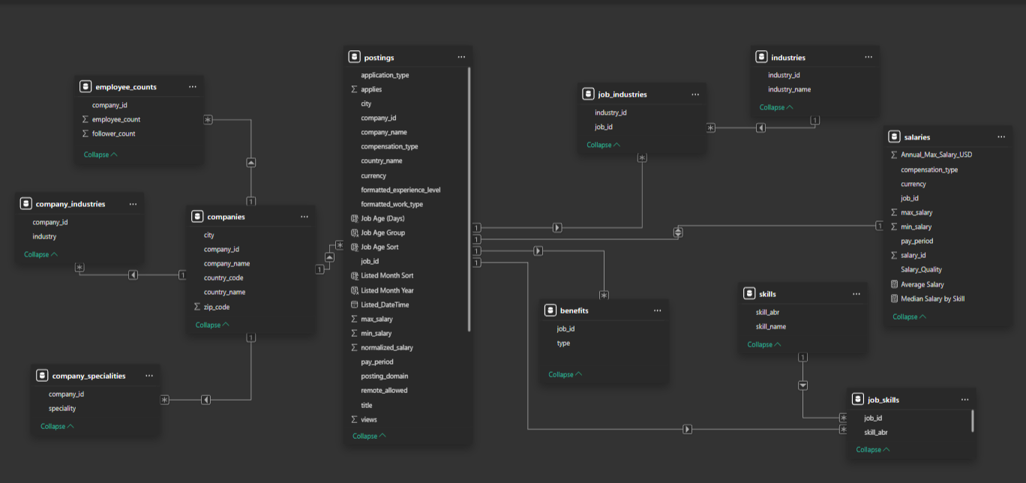

Slide 8
Technology Stack
1
Excel
Initial data inspection, formatting, and handling missing values.
2
ETL Process
Extracting, transforming, and loading LinkedIn job data into Power BI.
3
Power BI
Data modeling, interactive dashboard development, and KPI cards.

Slide 9
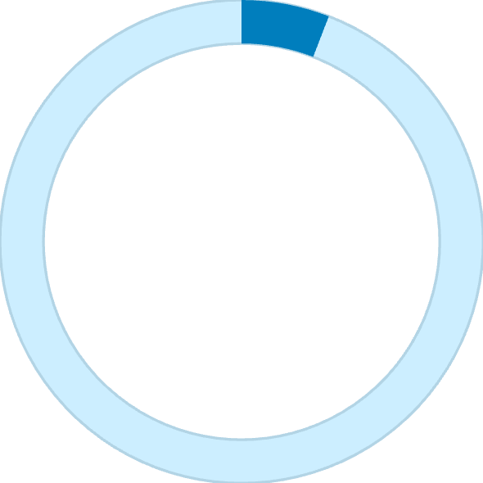
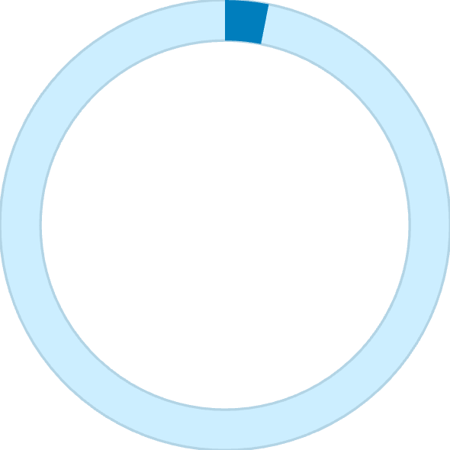

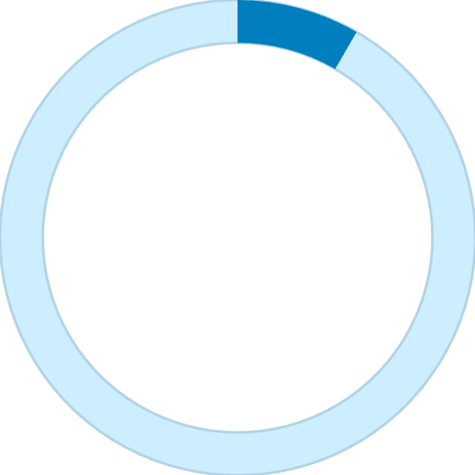
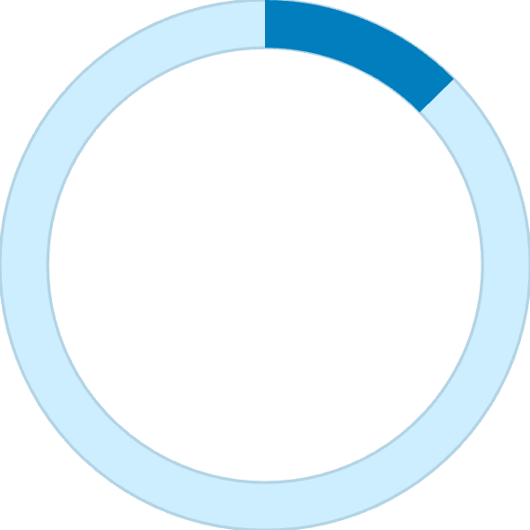
Key Metrics
5.88K
3.11K
$255K
Total Job Postings
Unique Companies
Average Salary (USD)
8.35
12.6%
Avg. Apps per Job
Remote Jobs

Slide 10
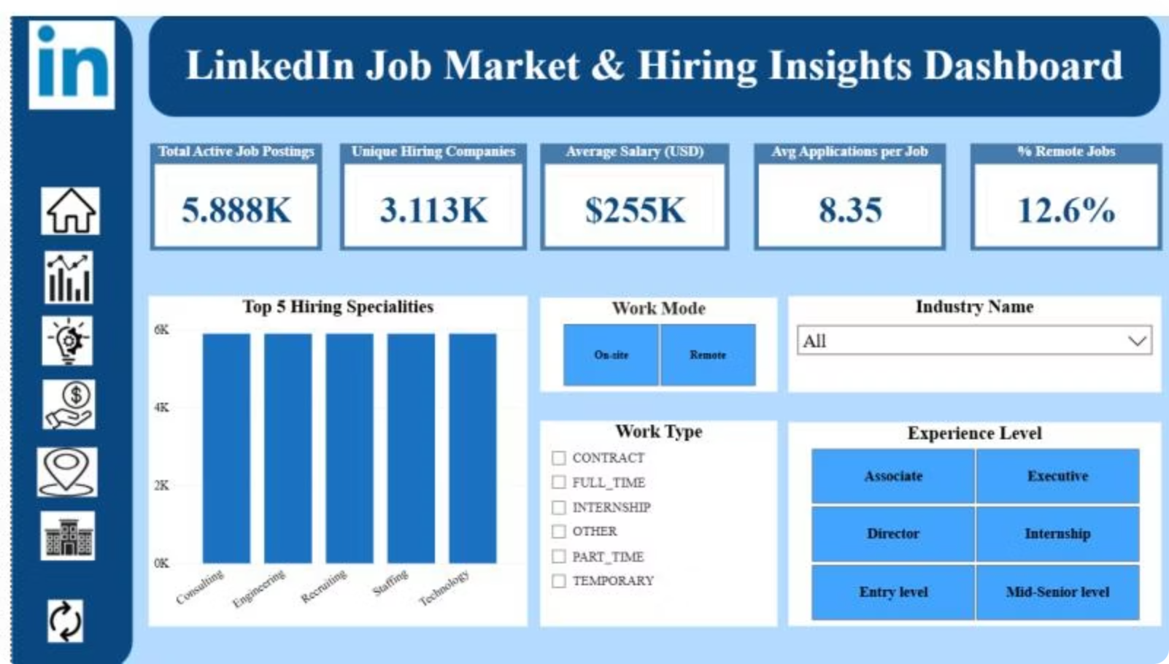
Dashboard Landing Page Overview
The "LinkedIn Job Market & Hiring Insights Dashboard" features a sidebar with LinkedIn icons and a main area with key metrics and interactive filters.

Slide 11
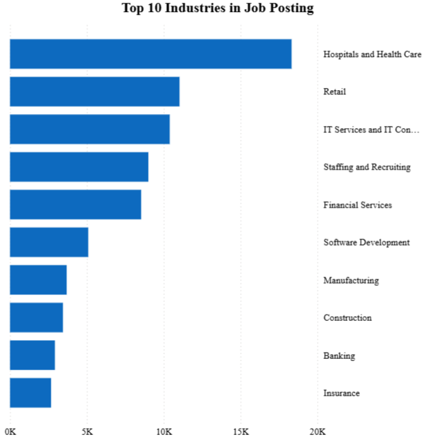
Key Visualizations on Market Trends
Top Industries by Job Postings
Bar chart for easy comparison of job counts across industries.

Slide 12
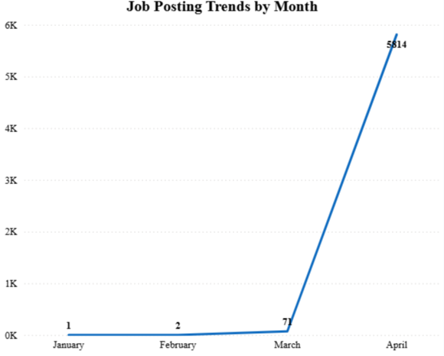
Monthly Job Posting Trends
Line chart clearly displays trends and fluctuations over time.

Slide 13
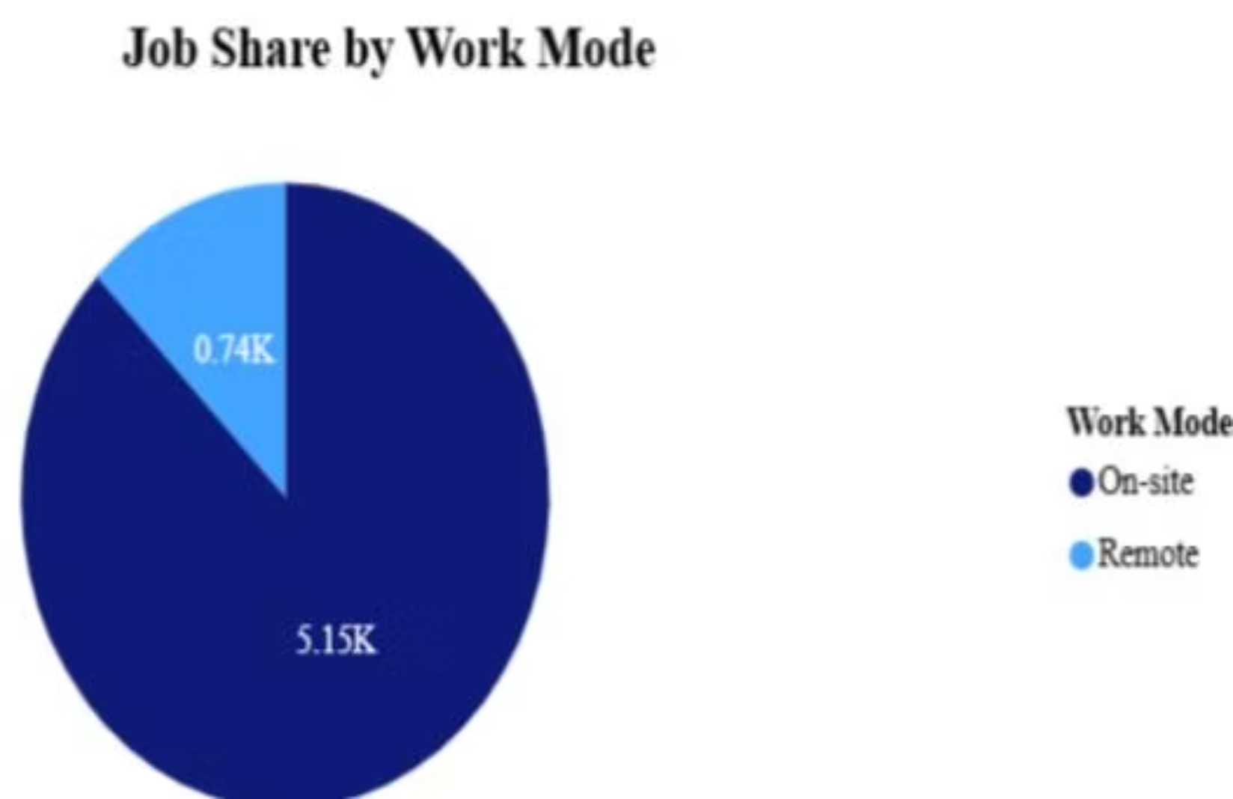
Key Visualizations on Distribution & Demand
Work Mode Distribution
Pie chart effectively shows percentage distribution of remote vs. on-site jobs.

Slide 14
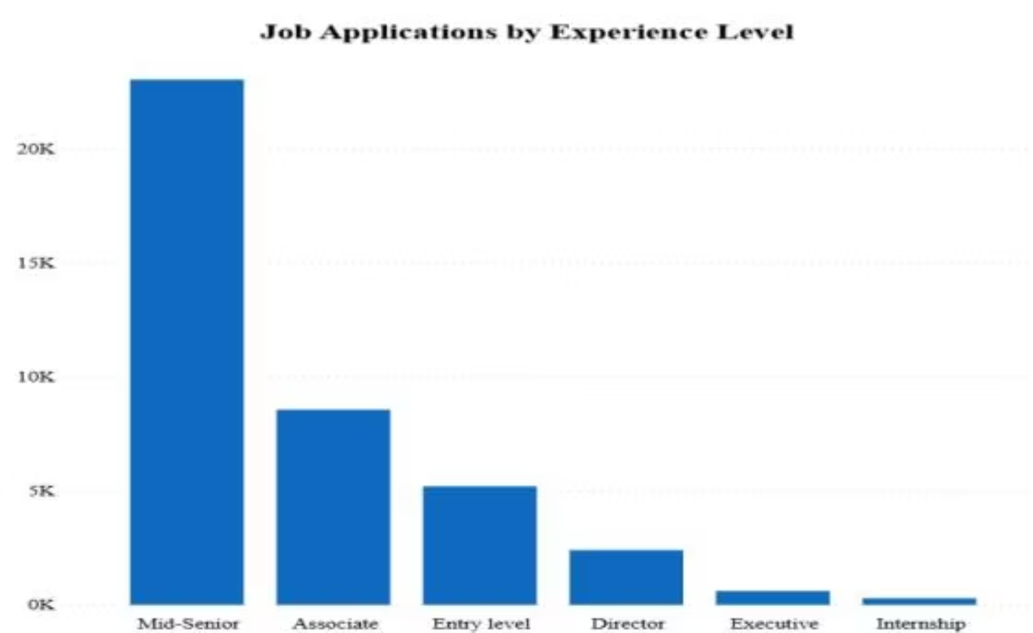
Experience Level Distribution
Horizontal bar chart improves readability for long category names and quick comparison.

Slide 15
Insights
IT sector records the highest number of job postings, indicating strong demand.
Mid-level roles offer the most competitive salary ranges across experience levels.
Remote jobs account for a significant share of total opportunities.
Hiring activity is concentrated among a few major companies.
Monthly trends reveal noticeable fluctuations in job postings.

Slide 16

Conclusion
The LinkedIn Job Market & Hiring Insights Dashboard transforms complex data into interactive, actionable intelligence.
Empowers Job Seekers
Optimizes Hiring
Informed career decisions based on market insights.
Recruiters can understand market dynamics and refine strategies.
Strategic Decisions
Faster, smarter, data-driven choices for all users.

Slide 17

Thank You!!

